Slide 1



How economical
is it?

Slide 2
The Ecodesign Directive (EU 1254/2014)
The directive is designed for ventilation and air conditioning units, where a portion or all of the air contaminated by indoor human activities or building emissions is replaced with fresh air taken from the outside.
Classification:
Residential Ventilation Units (RVU): Qmax ≤ 250 m3/h
Non-Residential Ventilation Units (NRVU): Qmax > 250 m3/h
Residential Ventilation Units (RVU)*: 1000 m3/h > Qmax > 250 m3/h
*Instances specified by the manufacturer for residential use.
Exceptional Applications:
Agricultural ventilation applications
Transportation applications
Exhaust hoods in industrial kitchens
Fresh air or exhaust units with a power consumption of 30 W or less and having a unidirectional airflow.
Units with each fan having a power consumption of 30 W or less and bidirectional airflow:
Axial or radial fans housed within a casing according to EU 327/2011
Fans operating in explosive environments
Emergency fans
Fans operating at very high or very low temperatures

Slide 3

The Ecodesign Directive (EU 1254/2014)
As of January 1, 2016, under Ecodesign directive, which is in effect, specific limit values have been established for components of air handling units, such as fans, heat recovery exchangers, and filter efficiency. Additionally, the directive includes rules regarding the operation of air handling units.
The directive is in effect with its revision as of January 1, 2018.

Slide 4
Air Handling Units (AHUs) for HVAC Systems
Single-direction (Supply or Exhaust) ventilation units (AHUs)
Ecodesign directives refer to the collection of laws within the European Union that establish energy usage criteria for energy-consuming products. Manufacturers are legally obligated to comply with these criteria.
The directives have been examined under specific headings for each product group, and LOT6, covering ventilation units and air handling units, was adopted by the European Parliament in 2013 with the directive number EU 1254/2014, and it came into effect. Ecodesign directives, prepared by European Council with the aim of replacing less energy-efficient products in the market with more efficient ones, have been accepted as a prerequisite for the CE certificate with specified dates. This has restricted the entry of non-compliant units into EU countries.

Slide 5
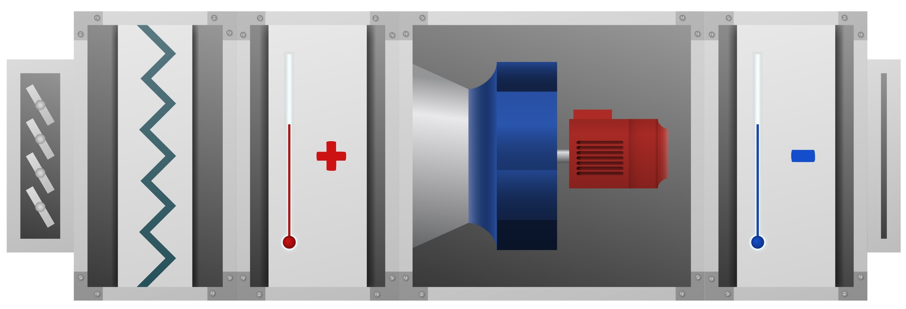
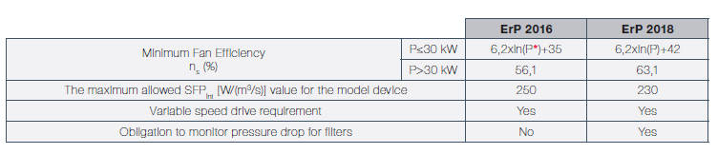
Air Handling Units (AHUs) for HVAC Systems
Single-direction (Supply or Exhaust) ventilation units (AHUs)
The airflow is unidirectional (either exhaust or supply air only).
The unit is equipped with a filter of F7 class or higher.
There is one or more fans within the unit, all in the same air duct.

Slide 6
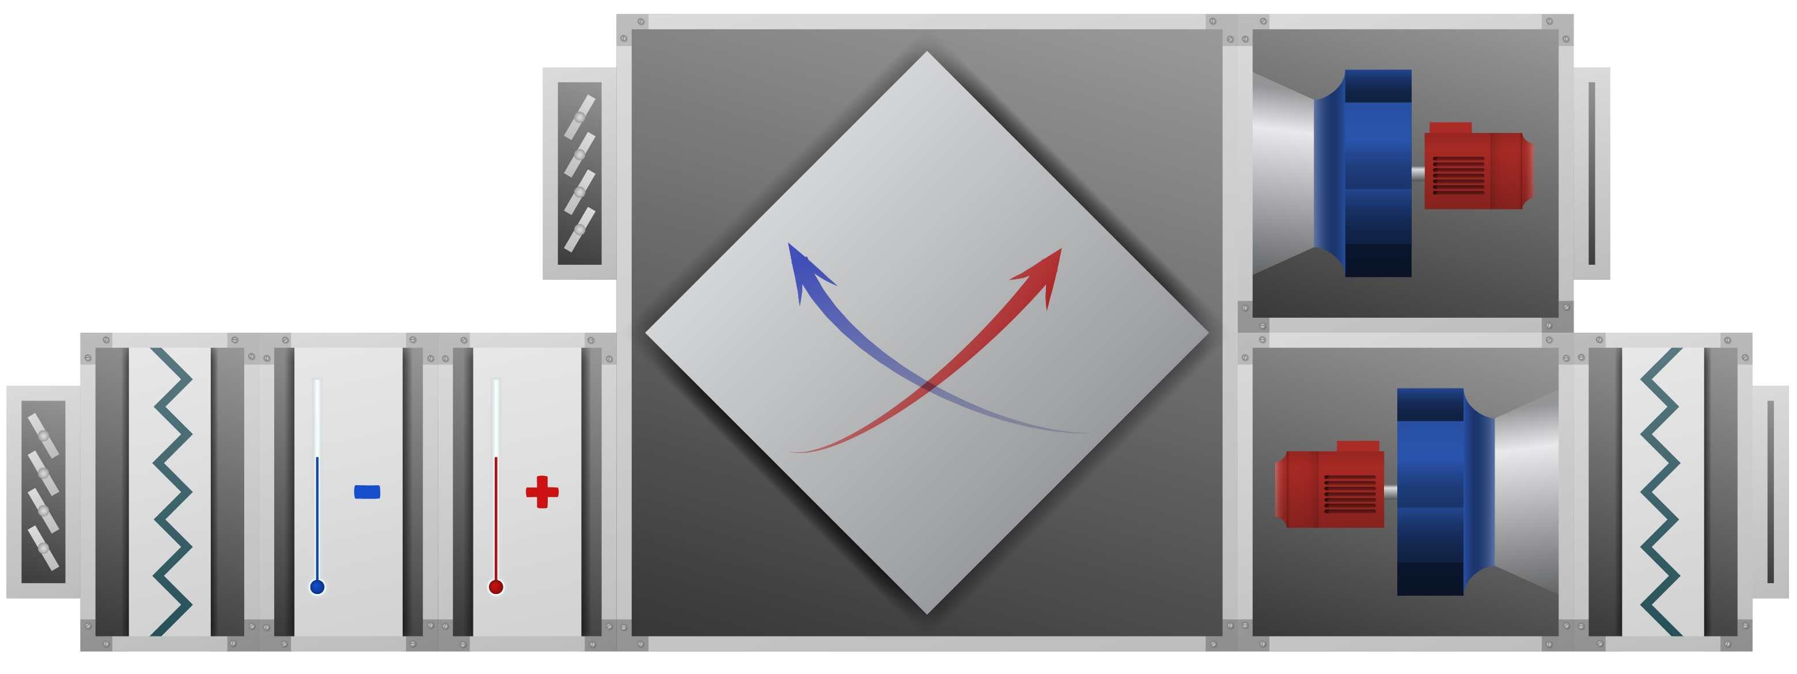
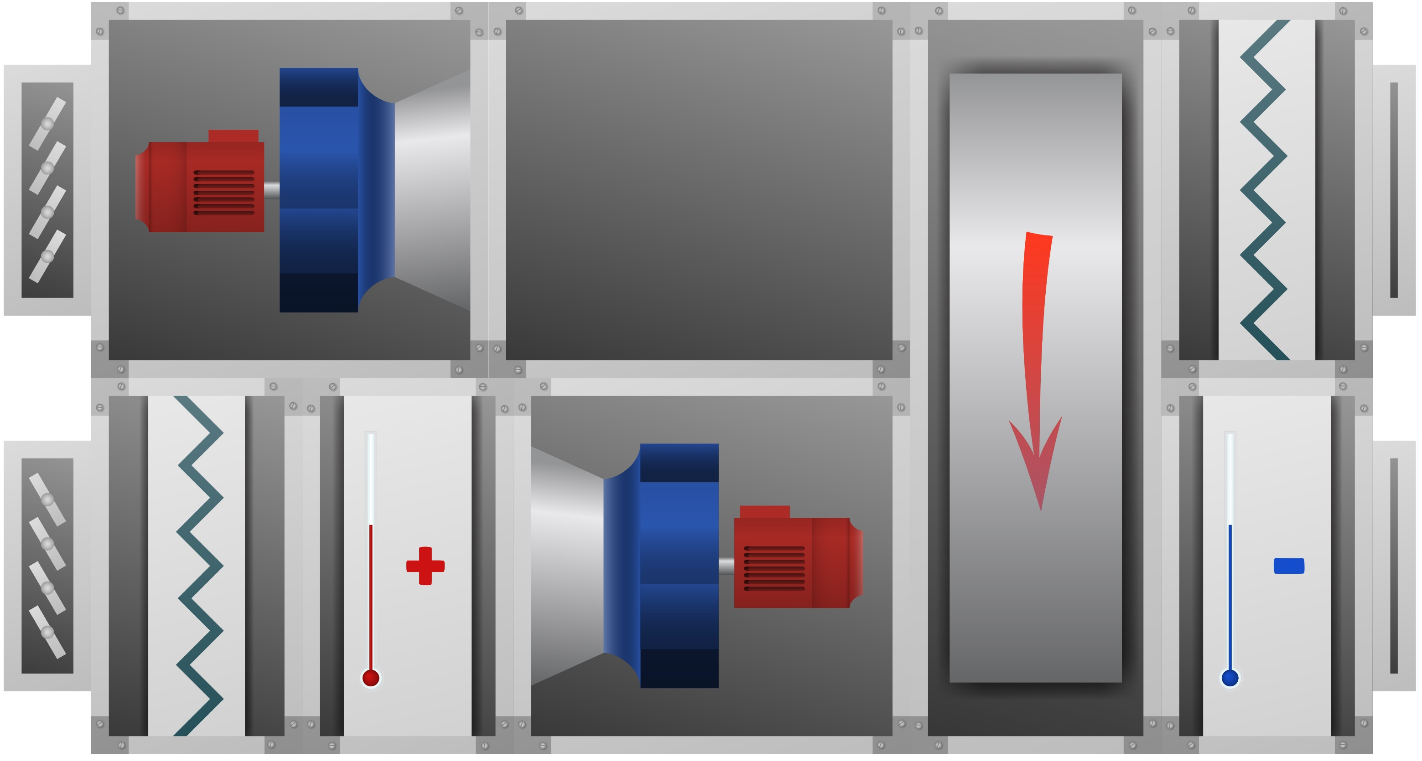
Air Handling Units (AHUs) for HVAC Systems Bidirectional (Supply and Exhaust simultaneously) ventilation units (AHUs)
The airflow is bidirectional (both supply and exhaust air).
There is at least an F7 class filter on the supply air side and at least an M5 class filter on the exhaust air side.
The unit is equipped with a heat recovery system (HRS/IGK).

Slide 7
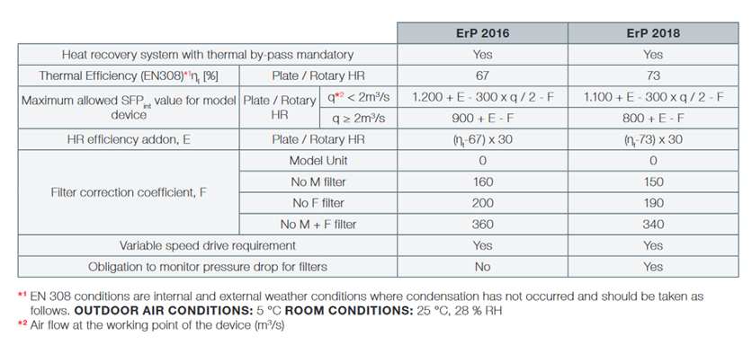
Air Handling Units (AHUs) for HVAC Systems
Bidirectional (Supply and Exhaust combined) ventilation units (AHUs)

Slide 8

What does Ecodesign require?
F7 filters should be used on the supply air side, and M5 filters should be used on the exhaust air side.
Heat recovery systems (HRS) should be implemented in the units.
Heat recovery efficiencies should be measured according to EN 308* conditions.
According to EN 308 conditions, specific indoor/outdoor air temperature conditions are considered, ensuring no condensation occurs, based on the values specified below.
OA :5 °C
RA : 25 °C, 28%RH
The measured Specific Fan Power (SFP) value for nominal flow should not exceed the specified SFPint value in the directive.

Slide 9
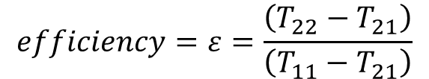
Efficiency Criterion
January 1, 2016:
Minimum thermal efficiency: 67%
Efficiency Bonus: E = (ηt – 0.67) * 3,000
January 1, 2018:
Minimum thermal efficiency: 73%
Efficiency Bonus: E = (ηt – 0.73) * 3,000
EN 308 conditions refer to indoor and outdoor air conditions where condensation does not occur, and they should be taken as follows:
OUTDOOR AIR CONDITIONS: 5°C
INDOOR CONDITIONS: 25°C, 28% RH
The thermal efficiency value in the supply air should be considered for supply and exhaust calculations.
$$efficiency=ε=\frac{\left(T_{22}−T_{21}\right)}{\left(T_{11}−T_{21}\right)}$$

Slide 10
Filtration Criterion
January 1, 2016:
F = 0 when fully compliant with reference values;
F = 160 when M5 filtration is not implemented;
F = 200 when F7 filtration is not implemented;
F = 360 when neither M5 nor F7 filtration is implemented.
January 1, 2018:
F = 150 when M5 filtration is not implemented;
F = 190 when F7 filtration is not implemented;
F = 340 when neither M5 nor F7 filtration is implemented.

Slide 11
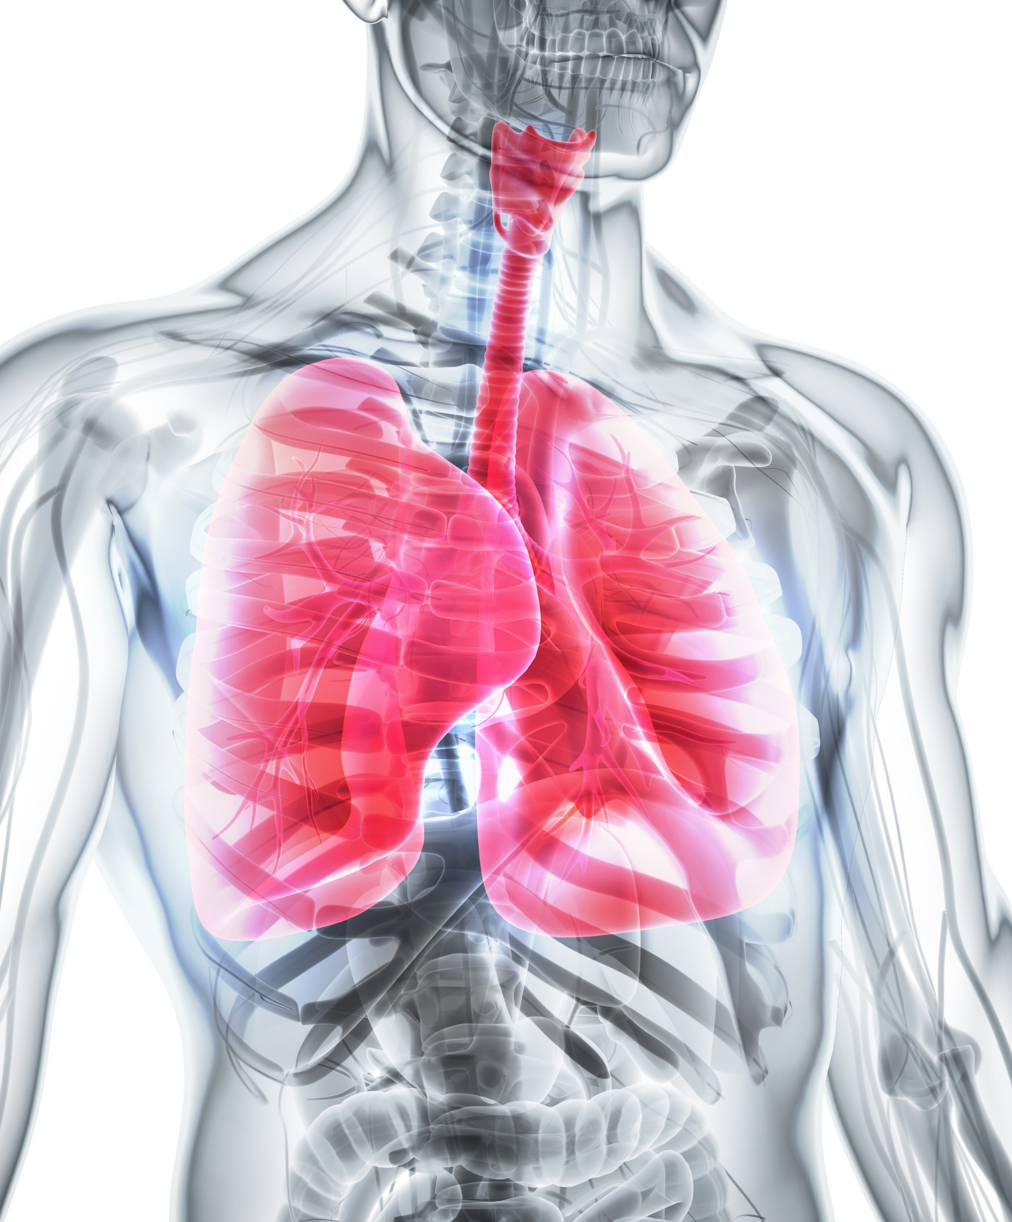
Filtration Criterion
PARTICLE SIZE IN THE AIR
EN 779:2012 | EN ISO 16890: Efficiency of the filter measured according to particle size
Filter Class | ePM₁ | ePM_{2.5} | ePM₁₀
M5 | %5-%35 | %10-%45 | %40-%70
M6 | %10-%40 | %20-%50 | %60-%80
F7 | %40-%65 | %65-%75 | %80-%90
F8 | %65-%90 | %75-%95 | %90-%100
F9 | %80-%90 | %85-%95 | %90-%100
>10 µm
10 µm
Bronchus
2.5 µm
Alveolus
1.0 µm

Slide 12
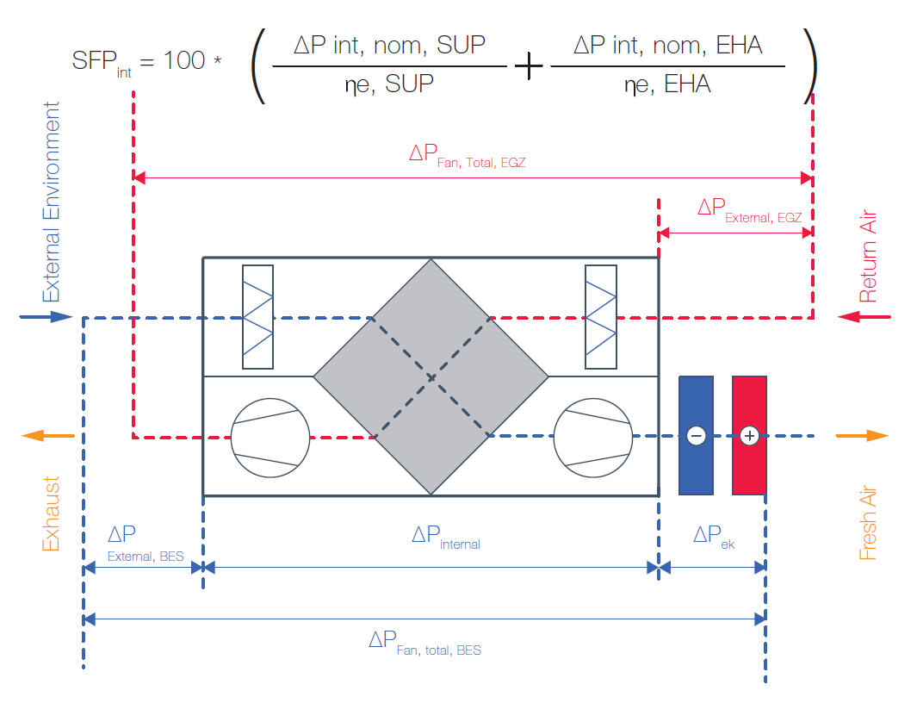
Calculation of Internal Specific Fan Power (SFPint)
SFP: Specific Fan Power (W/m3s-1)
According to EN 13779, the SFP value is calculated as the ratio of the airflow provided by the unit to the power consumed by the fans. In the Ecodesign directive, the SFP value is redefined as SFPint.
The SFPint value is related to the performance of the components used in the unit design and does not account for potential inefficiencies in the duct system, thus providing a more accurate comparison between units.

Slide 13
Internal Specific Fan Power (SFPint) Calculation
In the given calculation, pressure losses due to heat recovery exchanger, filter, and internal losses within the casing are defined as internal losses. These values, along with the efficiency of the fan at its operating point, are used to calculate the SFPint value of the units. The SFPlimit value is calculated using the formula specified in the criterion, and the two values are compared. Compliance with Ecodesign requires that the SFPint value is less than the SFPlimit value.

Slide 14
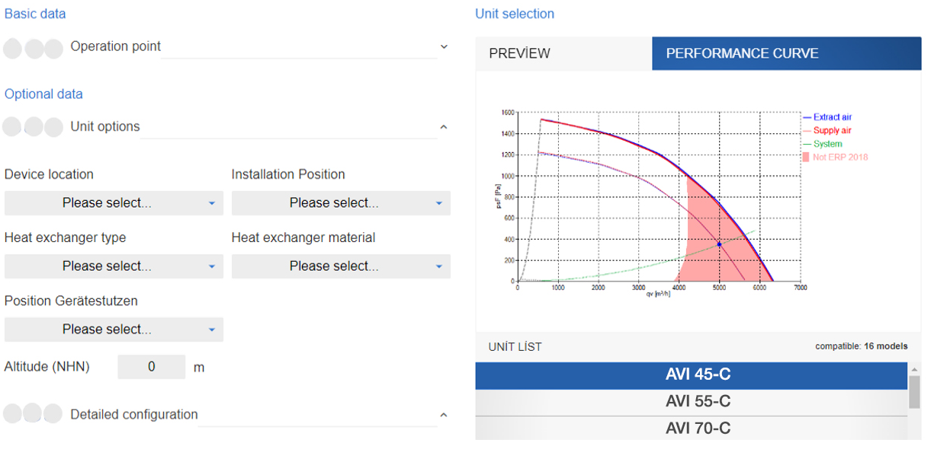
The manufacturer's Ecodesign compliance indication

Slide 15
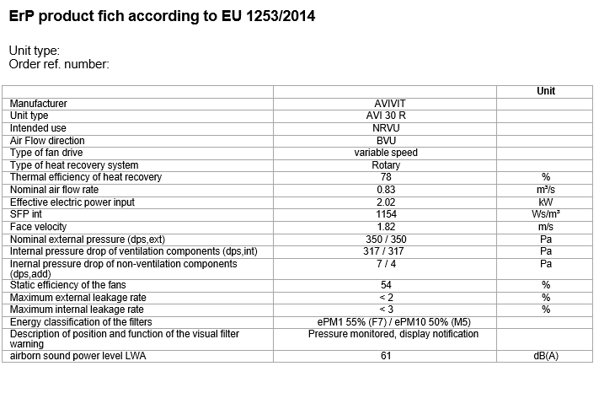
SFP Declaration

Slide 16

Directives:
2006/42/EC Machinery Directive
2009/125/EG, Ecodesign Directive, Commission Regulation (EU) No. 1253/2014 for Air Handling Units
2009/125/EG, Ecodesign Directive, Commission Regulation (EU) No. 327/2011 for Fans
Standards:
EN ISO 12100:2010 Machine Safety, General principles for design, risk assessment, and risk reduction
EN 60204-1:2006 Machine Safety, Electrical equipment of machines
EN61000-6-2 Electromagnetic Compatibility (EMC), Immunity for industrial environments
EN61000-6-3 Electromagnetic Compatibility (EMC), Emission in residential, commercial, and light-industrial environments
EN ISO 13857 Machine Safety, Safety distances to prevent hazard zones being reached by upper and lower limbs
EN ISO 13732-1 Ergonomics of the thermal environment, Methods for the assessment of human responses to contact with surfaces, Part 1: Hot surfaces

Slide 17
EN 308,
Single-direction (Supply or Exhaust) ventilation units (UVU)
EN 308 is used for determining the thermodynamic and air performance of an air handling unit incorporating a heat recovery exchanger. It covers the following tests:
Efficiency tests
a. Sensible heat transfer efficiency
b. Total heat transfer efficiency (for hygroscopic units)
c. Additional tests, including cold climate tests
Leakage tests
a. Internal leakage tests
b. External leakage tests
Pressure drop testsİç Kaçak

Slide 18
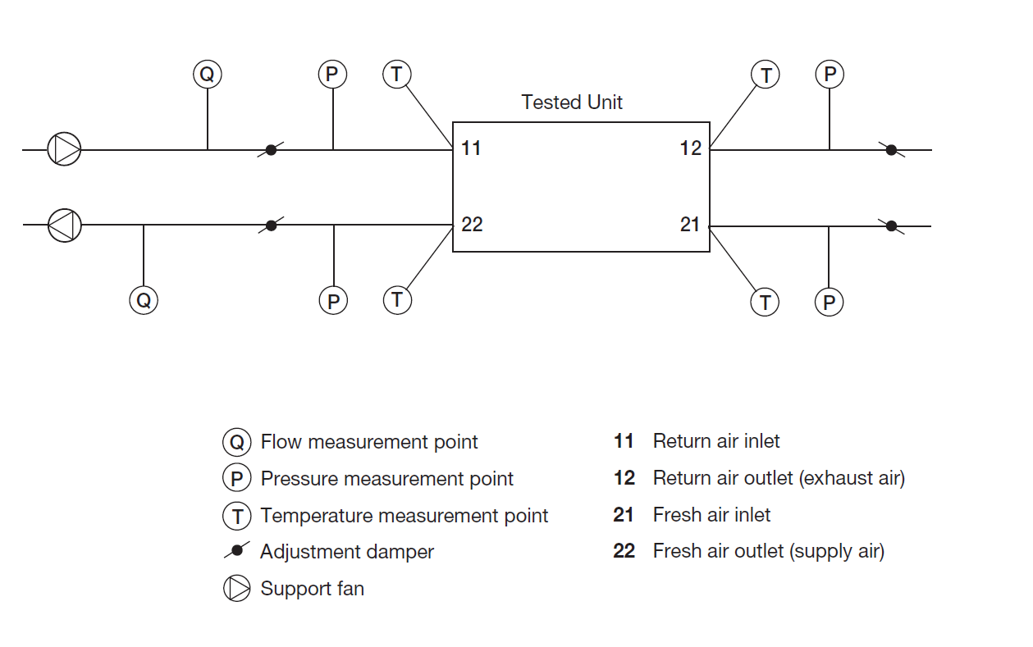
EN 308,
Efficiency tests
$$efficiency=ε=\frac{\left(T_{22}−T_{21}\right)}{\left(T_{11}−T_{21}\right)}$$
Sensible heat transfer efficiency:
T11=25°C DB, 14°C WB
T21=5°C DB
Total heat transfer efficiency:
T11=25°C DB, 18°C WB
T21=5°C DB, 3°C WB

